Slide 1
AsTeRICS v3.0 Plugin Development StringFormatter Example Martin Deinhofer, Department of Embedded Systems

Slide 2
Agenda
Plugin characteristics
Exercise definition
Setup development environment
ARE concept overview
Plugin creation
Build plugin
Plugin activation and testing

Slide 3
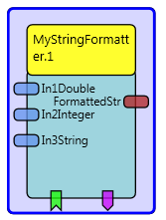

AsTeRICS Plugin
Is a functional block (component) with defined
input ports: receives data to be processed (e.g. face tracked coordinates)
output ports: send processed data (e.g. formatted string)
event listener: receive event and execute assigned action (e.g. left mouse click)
event trigger: send event to other functional blocks (e.g. time elapsed)
properties: Configure behaviour through property values

Slide 4
Exercise definition
Create AsTeRICS plugin: MyStringFormatter
User can define string formats similar to printf function in C (See Java-Class: Formatter)
Input port values to be formatted
Output port sends resulting formatted String
Event Listener sendFormattedStr
formats and sends formatted string to port formattedStr
Triggers event formattedStrSent

Slide 5
Exercise Example
String format
„%1$4.2f“
Code example
String formatted=String.format("%1$4.2f",3.32643423);
Resulting output string
3.33

Slide 6
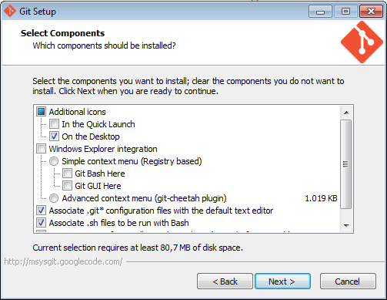
Setup Development Environment git Installation
Install GIT for Windows*
With the recommended settings in the screenshot (disable shell integration)
* Or use git client of your choice and OS

Slide 7
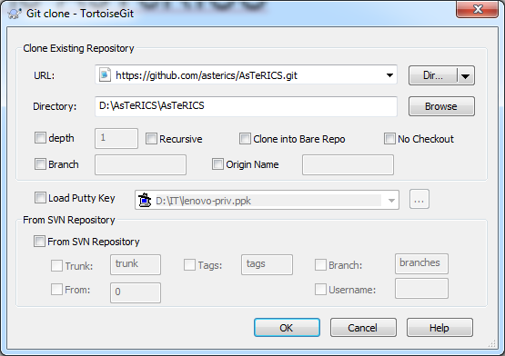
Setup Development Environment Clone AsTeRICS
Choose target folder for clone
Rightclick in explorer folder and select
Git Clone

Slide 8
Setup Development Environment JDK & Eclipse installation
Download and Install the Java Development Kit (JDK8, 32bit preferred)
Download and install/extract Eclipse for Java developers
In case of trouble, try to
Set “JAVA_HOME” to the JDK installation folder and add the JDK/bin path to the Environment Variable “Path”
and/or check the Developer Manual

Slide 9
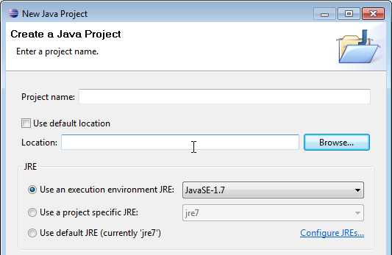
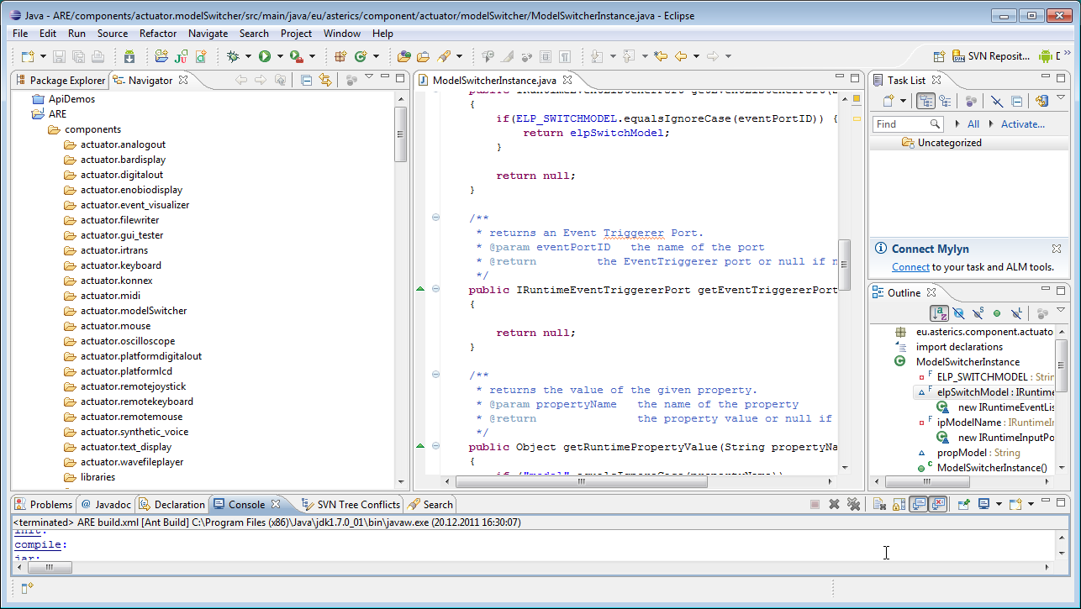
Setup Development Environment Create Eclipse Project
Start eclipse.exe
Choose File -> New -> Java Project in the Eclipse main menu, disable the option “Use default location” and browse to the ARE subfolder
You should get a project as shown in the right picture

Slide 10
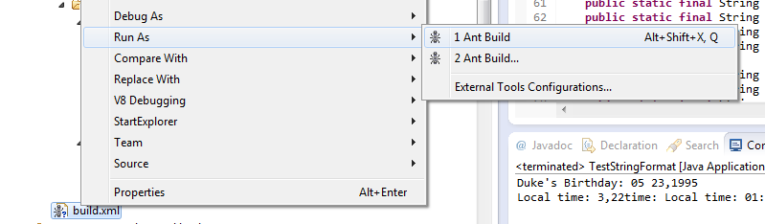
Build ARE
Right click on bulid.xml in the root folder of the ARE project
Run As -> Ant Build Note: ARE must not run during build
Or from commandline:
ant buildAllNoClean

Slide 11
Setup Development Environment Run ARE
Either
Go to bin/ARE folder
Start ARE with debug* output start_debug.bat
Or use ant target ant run-debug
* Other start files are: ARE.exe or start.bat

Slide 12
ARE folder structure
Important folders of source code repository
ACS: AsTeRICS Configuration Suite source code.
ARE: middleware and service layers and ARE components/plugins.
ARE/components: Source-code location of plugins, one folder per plugin. (LICENSE subfolder for involved licenses)
APE: tool and project template for creating standalone AsTeRICS-based SW packages
bin: subfolders where ARE, ACS and APE executable files are placed during the build flow.
Documentation: contains the User- and the Developer Manual, an OSKA manual and the license information for AsTeRICS source code and third party libraries.

Slide 13
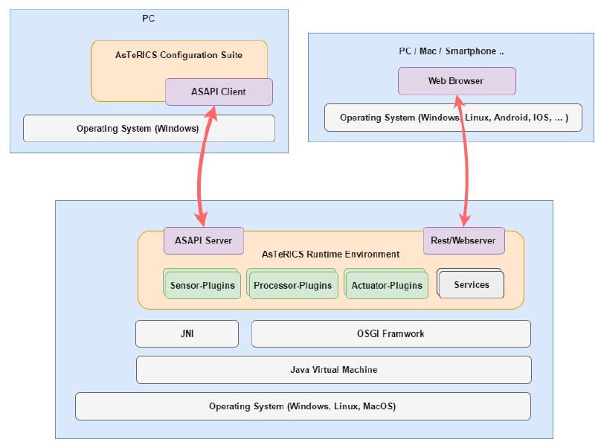
ARE concept
ARE middleware provides Runtime Environment for components/plugins
Components based on OSGi
Components can be
Sensors: Sense and create/send data (e.g. face tracker)
Processors: Process data (e.g. calculate moving average of data)
Actuators: Control environment (e.g. mouse cursor)

Slide 14
Plugin Development Workflow
Plugin Creation Wizard →Generate plugin folder structure
src folder
ant build script
Manifest file
Bundle descriptor
…
Add plugin to Eclipse project
Implement plugin functionality
Build project and run ARE
ACS: Create test model with plugin
Do „Download Component Collection“ first

Slide 15
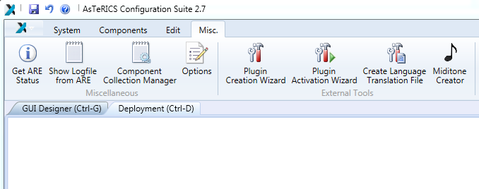
Plugin Creation Wizard

Slide 16
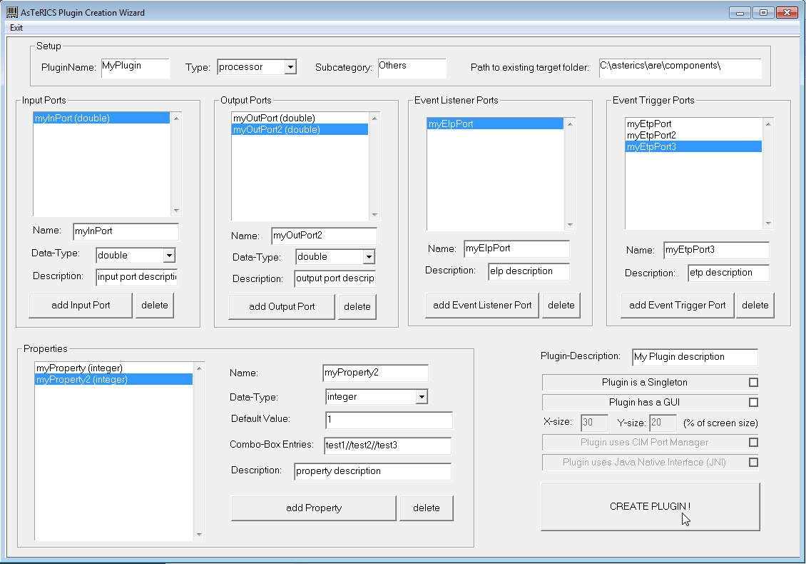
Plugin Creation Wizard
Define characteristics of plugin
Generate folder structure, source code stubs and build script

Slide 17
Plugin Creation Wizard Common Parameter
PluginName: „MyStringFormatter“ (CamelCase notation)
Type: „processor“ (others: sensor, actuator)
Subcategory: „Event and String Processing“ (See existing ACS components)
Path to existing target folder: <AsTeRICS ROOT>/ARE/components

Slide 18
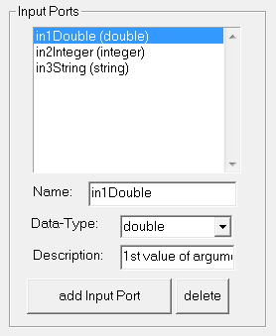
Plugin Creation Wizard Input Ports

Slide 19
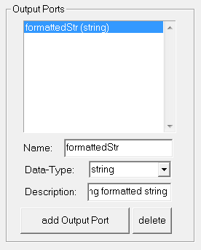
Plugin Creation Wizard Output Ports

Slide 20
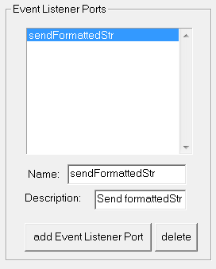
Plugin Creation Wizard Event Listener

Slide 21
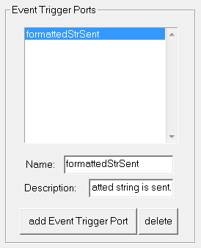
Plugin Creation Wizard Event Trigger

Slide 22
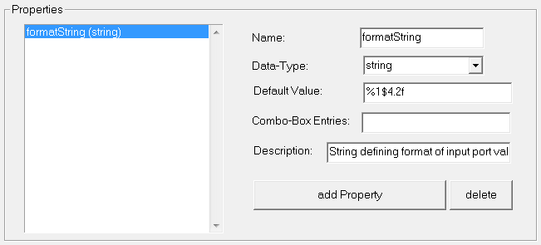
Plugin Creation Wizard Properties

Slide 23
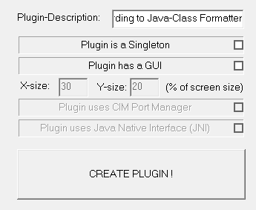
Plugin Creation Wizard Generate Plugin
Click to generate

Slide 24
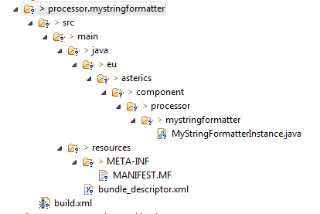
Plugin Creation Wizard Created folder structure
Java Source folder
Java template code
OSGI/Jar MANIFEST file
Plugin definition in xml notation
Ant build script for plugin

Slide 25
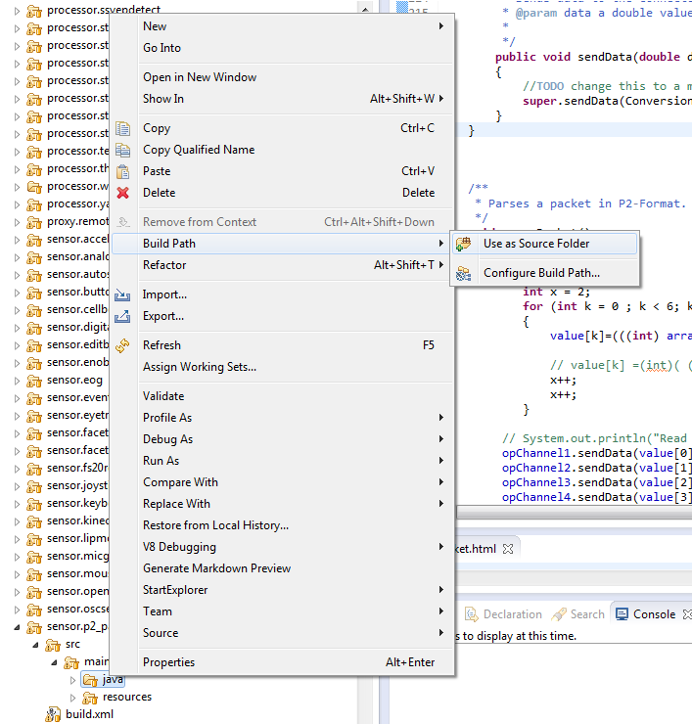
Source folder to Build Path
Add Java source folder to Build Path

Slide 26
Build Plugin and Run ARE
The target run-debug both builds the project and runs the ARE:
ant run-debug
Note: Close running ARE before

Slide 27
Start ACS/WebACS and test plugin
Go to bin/ACS folder
Start ACS.exe or press F8 (to edit current model)
Click „Connect to ARE“
Click „Download Component Collection“
Add new plugin from Components tab

Slide 28
Member variables
final IRuntimeOutputPort opFormattedStr = new DefaultRuntimeOutputPort();
// Usage of an output port e.g.: opMyOutPort.sendData(ConversionUtils.intToBytes(10));
final IRuntimeEventTriggererPort etpFormattedStrSent = new DefaultRuntimeEventTriggererPort();
// Usage of an event trigger port e.g.: etpMyEtPort.raiseEvent();
String propFormatString = "%1$4.2f";
// declare member variables here
//Hold values of incoming input port data
private Double in1Double;
private Long in2Integer;
private String in3String;

Slide 29
Property setting & getting
/**
* returns the value of the given property.
* @param propertyName the name of the property
* @return the property value or null if not found
*/
public Object getRuntimePropertyValue(String propertyName)
{
if ("formatString".equalsIgnoreCase(propertyName))
{
return propFormatString;
}
return null;
}
/**
* sets a new value for the given property.
* @param propertyName the name of the property
* @param newValue the desired property value or null if not found
*/
public Object setRuntimePropertyValue(String propertyName, Object newValue)
{
if ("formatString".equalsIgnoreCase(propertyName))
{
final Object oldValue = propFormatString;
propFormatString = (String)newValue;
return oldValue;
}
return null;
}

Slide 30
Converting incoming port data
/**
* Input Ports for receiving values.
*/
private final IRuntimeInputPort ipIn1Double = new DefaultRuntimeInputPort()
{
public void receiveData(byte[] data)
{
//Convert incoming data to a double value.
in1Double = ConversionUtils.doubleFromBytes(data);
}
};
private final IRuntimeInputPort ipIn2Integer = new DefaultRuntimeInputPort()
{
public void receiveData(byte[] data)
{
//Convert incoming data to a Long (not int) value, because Formatter class expects Long value instead of int.
in2Integer=new Long(ConversionUtils.intFromBytes(data));
}
};
private final IRuntimeInputPort ipIn3String = new DefaultRuntimeInputPort()
{
public void receiveData(byte[] data)
{
//Convert incomding data to a String value.
in3String=ConversionUtils.stringFromBytes(data);
}
};

Slide 31
Formatting & Sending Data
/**
* Formats and sends the resulting foramtted string to the output port.
*/
private void formatAndSendString() {
//get current format string
String curFormatString=(String)getRuntimePropertyValue("formatString");
//Execute actual formatting of string
String formattedString=String.format(curFormatString, in1Double,in2Integer,in3String);
//Convert formatted string to byte[] and send it to the output port
opFormattedStr.sendData(ConversionUtils.stringToBytes(formattedString));
//Inform others, trigger event
etpFormattedStrSent.raiseEvent();
}

Slide 32
Implement Event Listener
/**
* Event Listerner Ports.
*/
final IRuntimeEventListenerPort elpSendFormattedStr =
new IRuntimeEventListenerPort()
{
public void receiveEvent(final String data)
{
formatAndSendString();
}
};

Slide 33
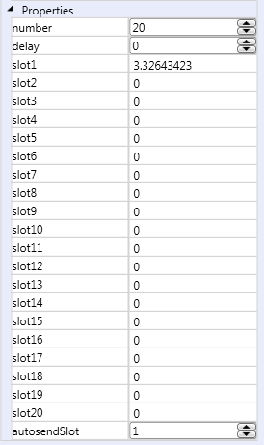

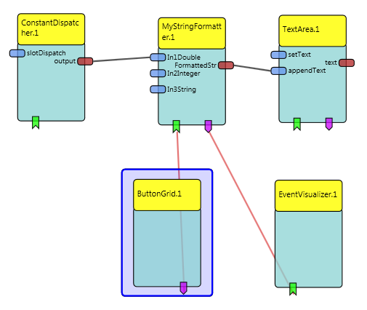
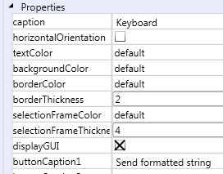
Test model
button1→sendFormattedStr
formattedStrSent → eventDisplay

Slide 34
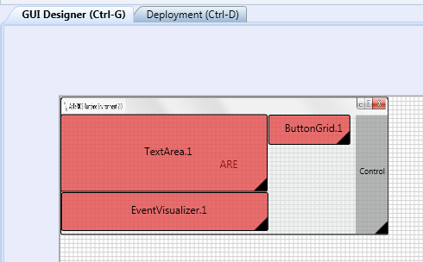
Test model – GUI Designer

Slide 35
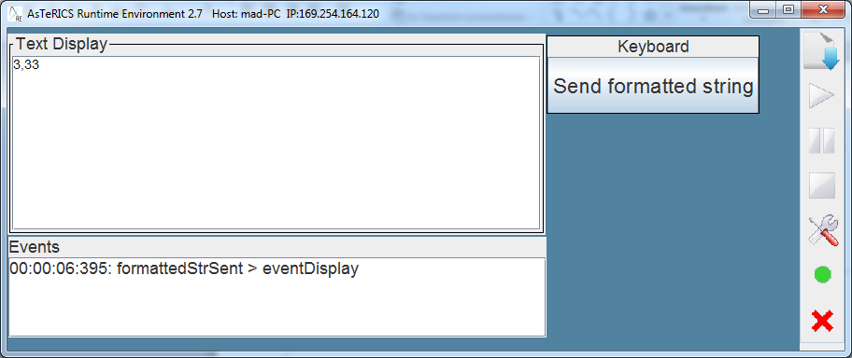
Model Result
Click on button „Send formatted string“

Slide 36
Plugins with Resources
For some plugins you might need to read the contents of some files (configuration files, images,...) or write to a file.
Use ResourceRegistry API
Example
Get URI of image resource
URI myURI =
ResourceRegistry.getInstance().getResource("pictures/slide7.jpg", RES_TYPE.DATA);
Get contents of text file in data/scripts folder
String contents = ResourceRegistry.getInstance().getResourceContentAsString("scripts/script.js",RES_TYPE.DATA);

Slide 37
Plugin License Files
The author of a plugin must provide the license files of the plugin
The license of self-authored code
The license of used third-party code
Put all the files into the folder ARE/components/<mycomponent>/LICENSE
Use this file name convention

Slide 38
Plugin Help File
Provide a help which is shown when pressing F1
Copy another help file and save it to the appropriate location: Documentation/ACS-Help/HTML/Plugins
The name of the file must be the name of the plugin

Slide 39
Modifying a Plugin
You must edit the file AsTeRICS/ARE/components/<mycomponent>/src/main/resources/bundle_descriptor.xml
and update your code accordingly

